Slide 1

SCET-MITWPU College Event Management Web Development (In-House Project)
Sr.No | Panel | Name | PRN
1 | A | Rhythm Sethiya | 1032212447
2 | B | Akarsh Singh | 1032212466
3 | B | Ayushmaan | 1032212491
4 | B | Aryan Sharma | 1032212492
Name of BTech Capstone Project Guide :Dr Nikhil Mhala
Group no – P70

Slide 2
Table of Contents
Introduction
Problem Statement
Objectives
Literature Survey
Requirement Gathering
Project Timeline
System Features
System Architecture
Database Design
Implementation Details
Security Measures
Testing
Individual Contributions
Future Aspects
Conclusion
References

Slide 3
Introduction
Purpose:
To streamline the process of managing college events efficiently.
Provide a centralized platform for event creation, updates, and participant management.
Ensure seamless communication between students, faculty, and event organizers.
Key Features:
Online Event Creation: Organizers and admins can create and manage events.
Participant Registration: Students can easily register for events online.
Mail Notifications: Automated emails for event updates, cancellations, or postponements.
Role-Based Management: Access permissions based on user roles (Student, Faculty, Admin Faculty, Event Organizer).
Secure Data Handling: Password hashing, OTP verification, and secure login ensure data integrity.

Slide 4
Problem Statement
Colleges organize numerous events throughout the academic year, often involving multiple stakeholders such as students, faculty, and event organizers. Managing these events manually can be inefficient, leading to miscommunication, scheduling conflicts, and poor event participation. There is a need for a streamlined, centralized system that can efficiently handle event planning, management, and communication for all college-related activities.
The key challenges include:
Lack of a unified platform to compile and display all college events.
Difficulty in ensuring secure access and role-based management of event data.
Inefficiencies in event information retrieval and participant engagement.
Thus, there is a need for a web-based College Event Management System that offers a comprehensive solution for organizing, managing, and participating in college events. This system should allow students, faculty, and organizers to access event details, interact with them, and improve the overall experience of event participation.

Slide 5
Objectives
User-Friendly Interface
Design an intuitive and interactive platform that simplifies event management for users.
Ensure ease of navigation for students, faculty, and event organizers with dedicated dashboards.
Efficient Tracking
Centralize all event-related data, including registrations, schedules, and updates.
Allow users to track event statuses (pending, approved, or canceled) in real time.
Scalability
Develop a system architecture capable of supporting an increasing number of users and events.
Design the database and backend logic to accommodate future enhancements and higher traffic.

Slide 6
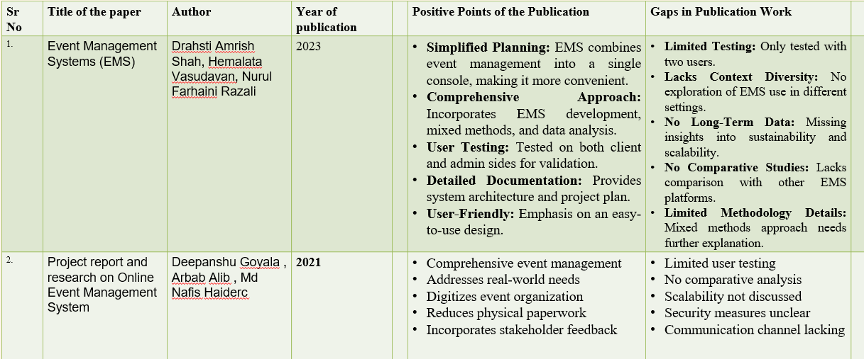
Literature Survey

Slide 7
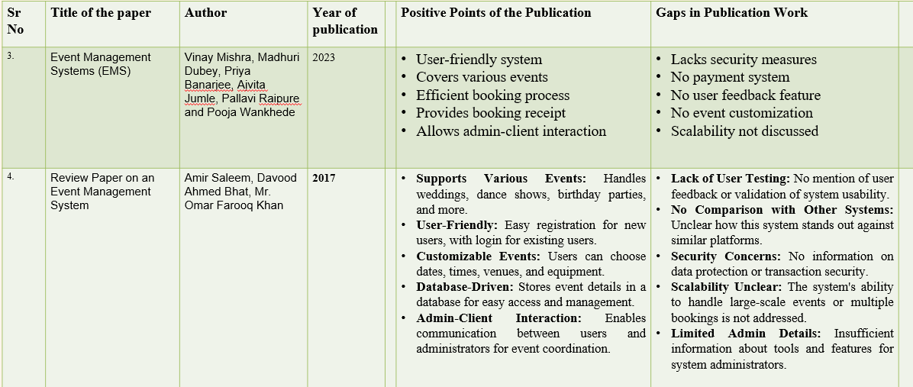
Literature Survey

Slide 8
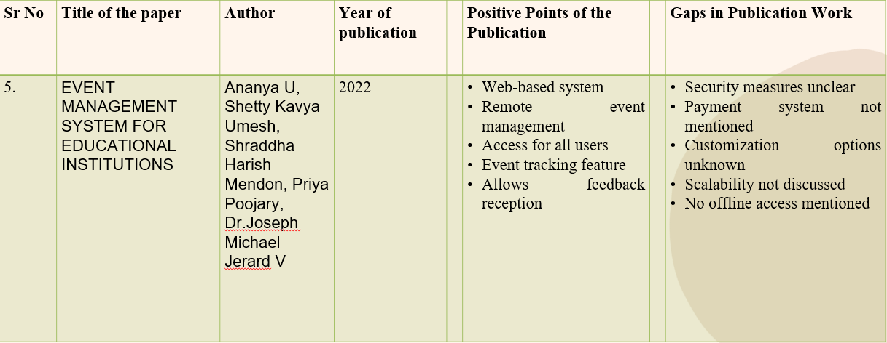
Literature Survey

Slide 9
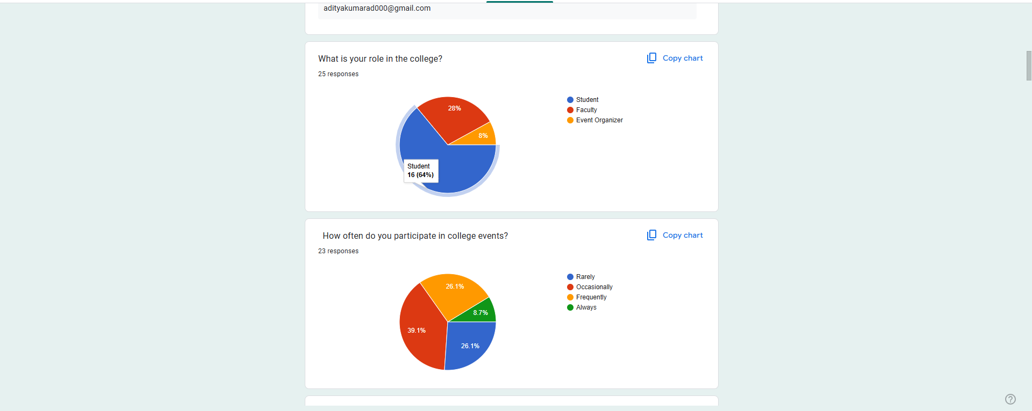
Requirement Gathering
Activities:
Conducted Google Form survey to gather feedback from students, faculty, and event organizers.
Analyzed responses to identify pain points and role-specific requirements.

Slide 10
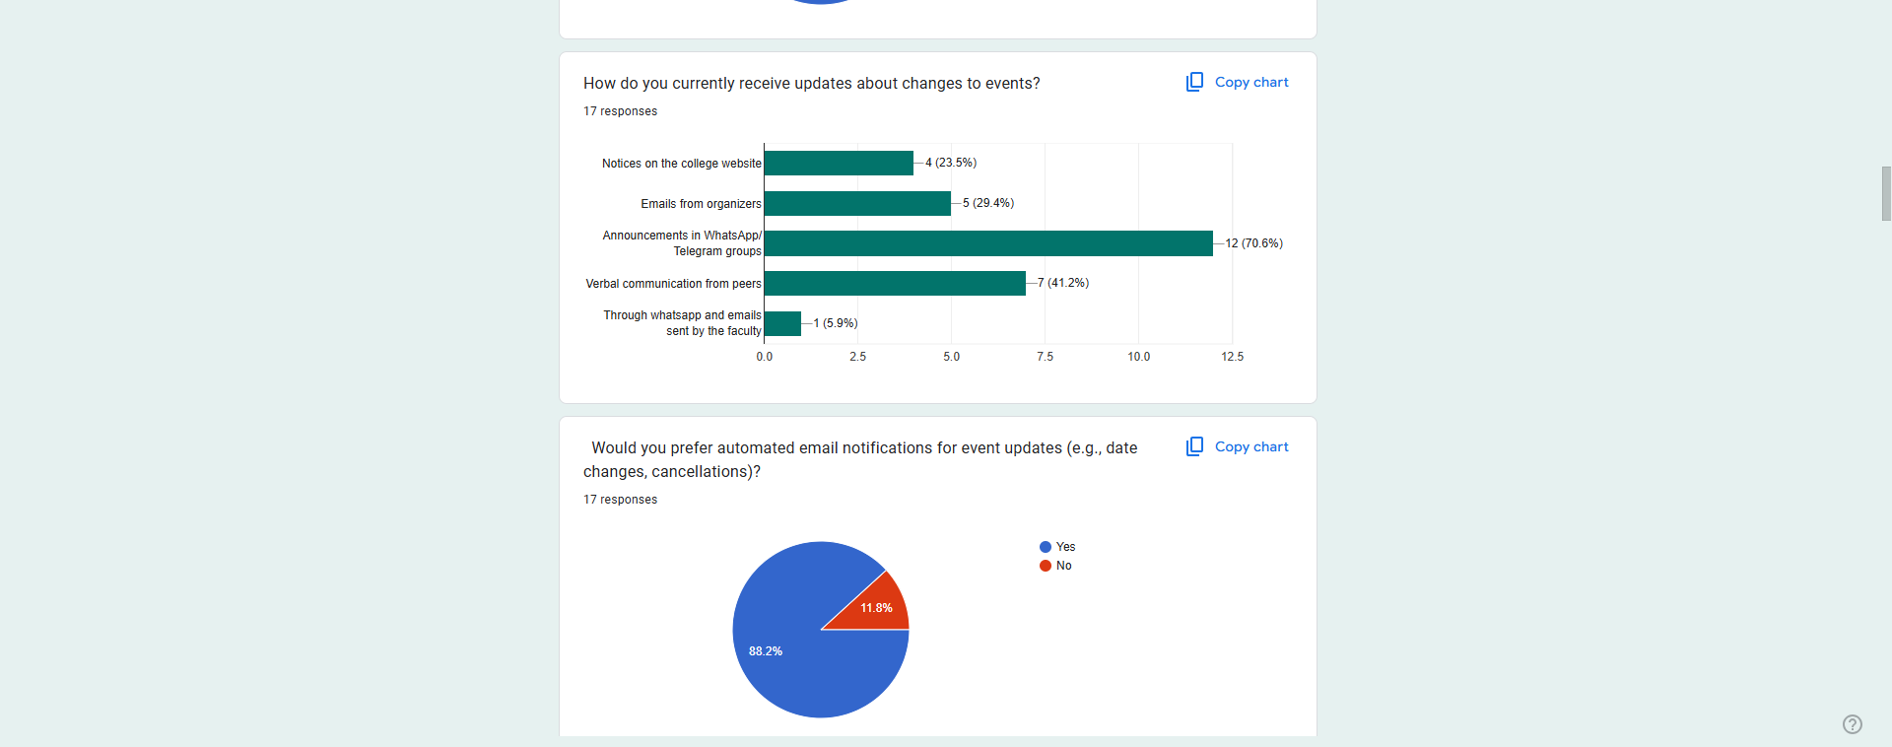
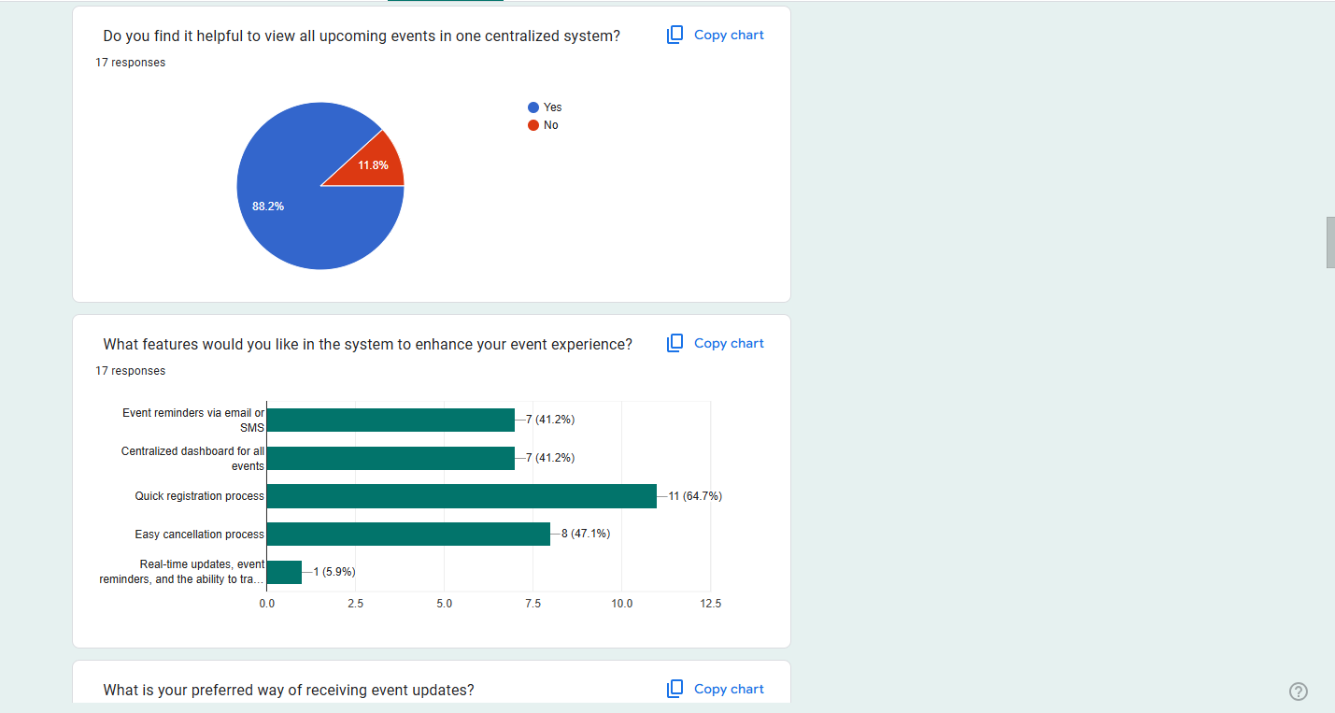
Student Requirement Analysis

Slide 11
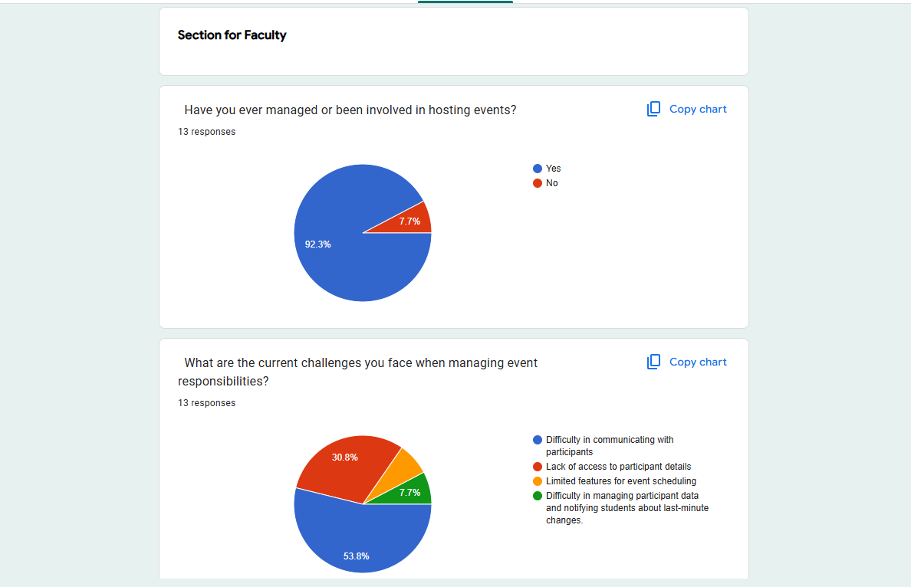
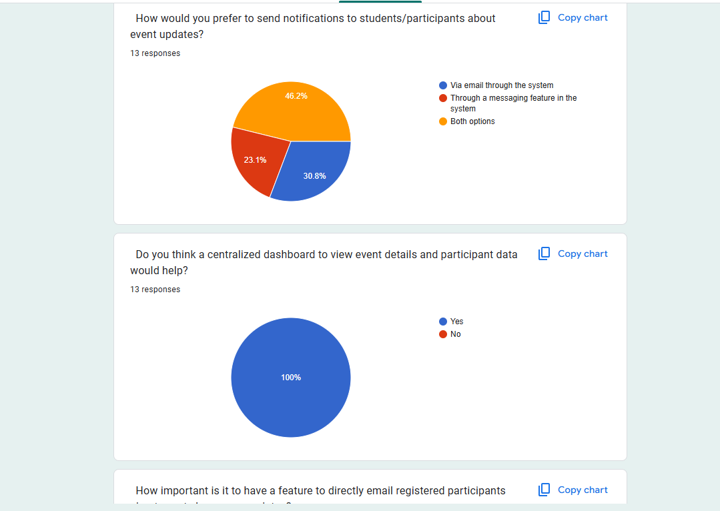
Faculty Requirement Analysis

Slide 12
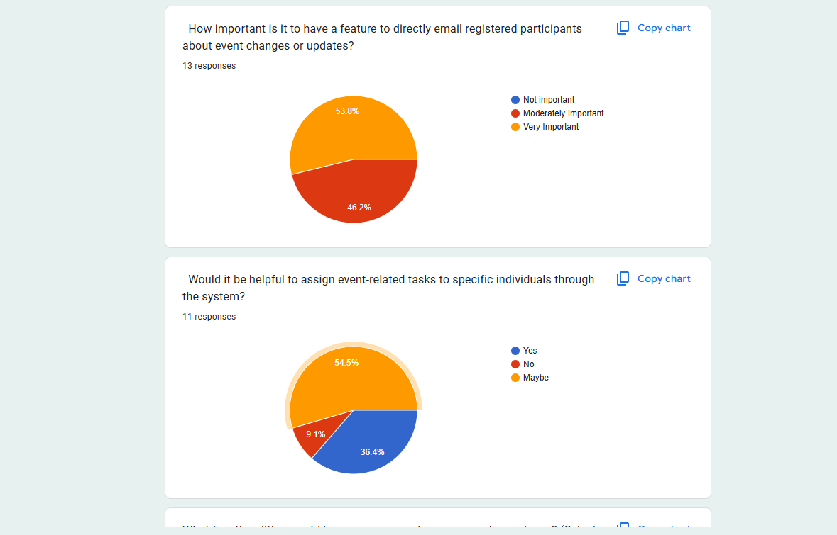
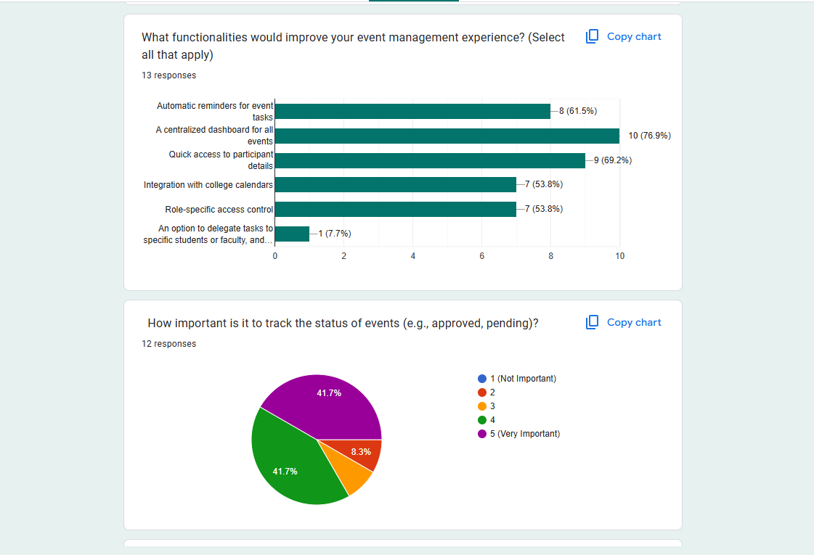
Faculty Requirement Analysis

Slide 13
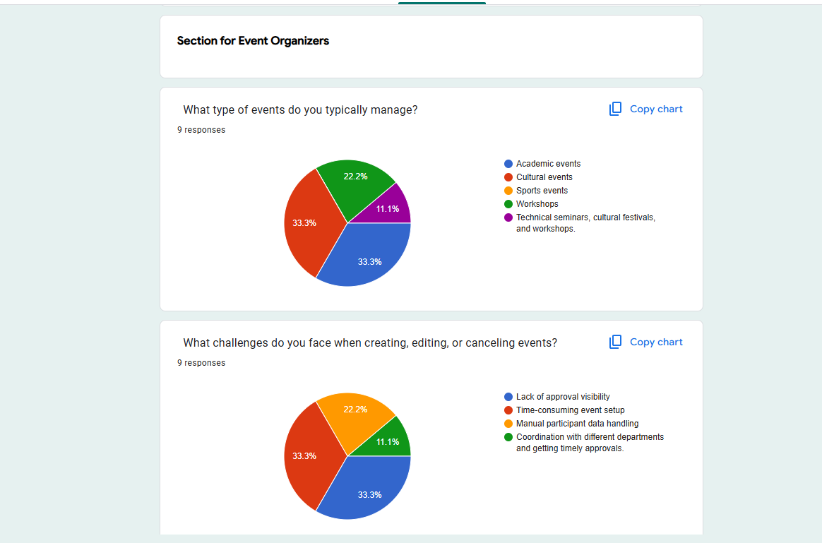
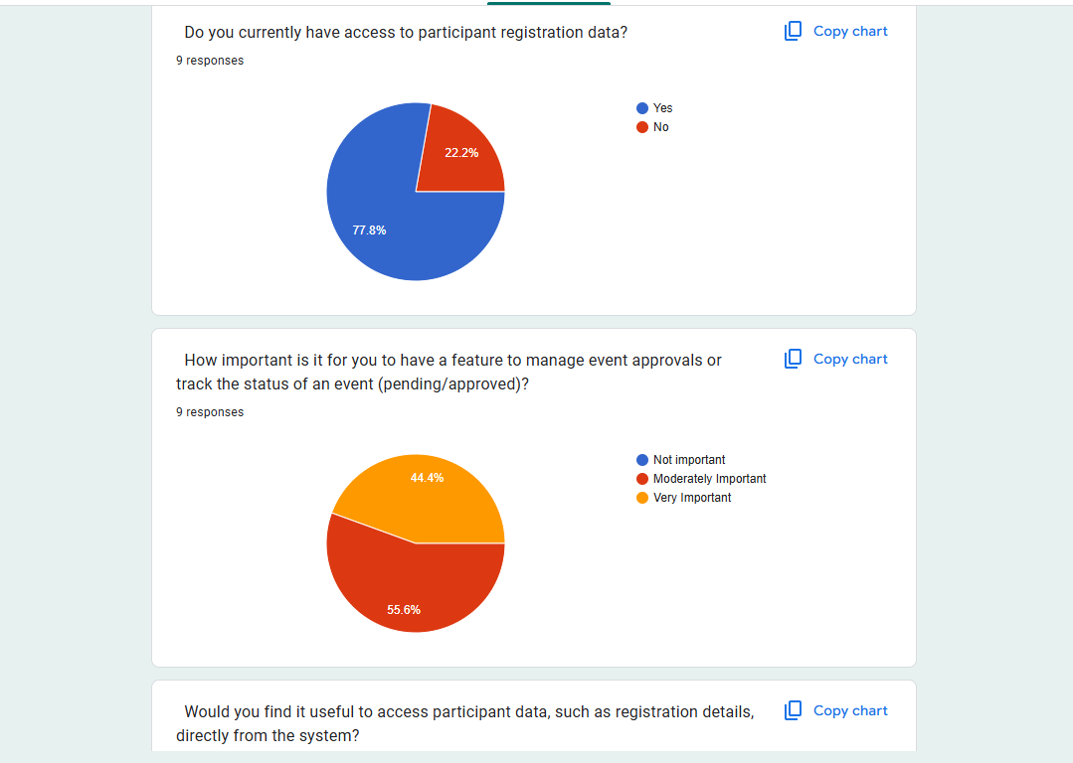
Event Organiser Requirement Analysis

Slide 14
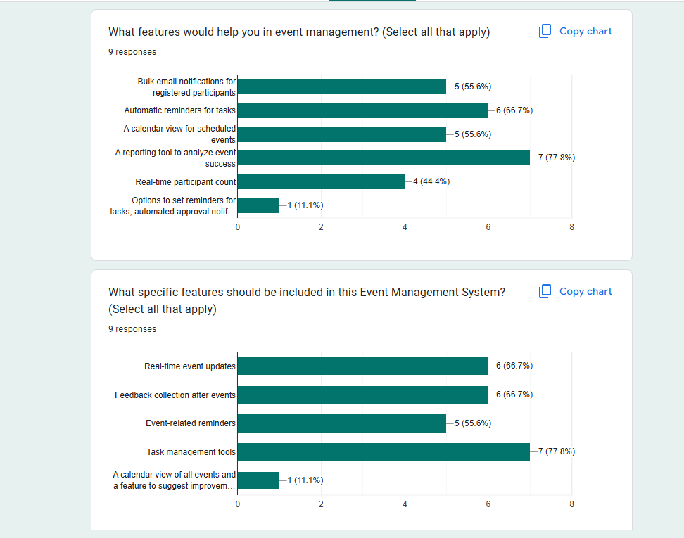
Event Organiser Requirement Analysis

Slide 15
H/w Requirements
Hardware Requirements:
Processor: Multi-core CPU (e.g., Intel i5/i7 or AMD Ryzen 5/7) for efficient handling of multiple processes.
Memory: 8GB RAM (16GB recommended for smoother development and testing environments).
Storage: SSD with at least 256GB of storage (to store project files, databases, and application data).
Network: Reliable high-speed internet connection for accessing cloud services, API integrations, and online resources.
User Devices: Desktop/Laptop with a web browser for development, testing, and accessing the Event Management System.

Slide 16
S/w Requirements
Software Requirements:
Operating System: Windows, macOS, or Linux (for development and deployment).
Programming Languages: JavaScript (for frontend and backend development using Node.js).
Frameworks and Libraries:
Frontend: HTML, CSS, JavaScript
Backend: Node.js, Express.js
Database Management: MySQL (for storing and managing event-related data)
Development Tools: Code Editor: Visual Studio Code, Sublime Text, or any other preferred code editor.
Version Control: Git/GitHub for version control and collaboration.
Testing Tools: Postman: For API testing and development.
Browser: Chrome, Firefox, or Edge (for testing and using the web application).

Slide 17
Project Timeline
Requirement Gathering (1 Week):
Collected stakeholder feedback and defined system features and roles.
System Design (2 Weeks):
Designed UI, system architecture, database schema, and use case diagrams.
Implementation (3 Weeks):
Developed frontend, backend, and database integration with core features.
Testing (1 Week):
Validated functionality, security, and performance through comprehensive testing.
Deployment (1 Week):
Deployed the system for real-world use.

Slide 18
System Features
1. Student Page:
Seamless event registration.
Notifications about event updates via mail.
2. Faculty Page:
Ability to communicate with students.
Restricted to managing assigned events.
3. Admin Faculty Page:
Oversee all events and users.
Approve, deny, and assign event responsibilities.
4. Event Organizer Page:
Full control over event creation, modification, and participant data.

Slide 19
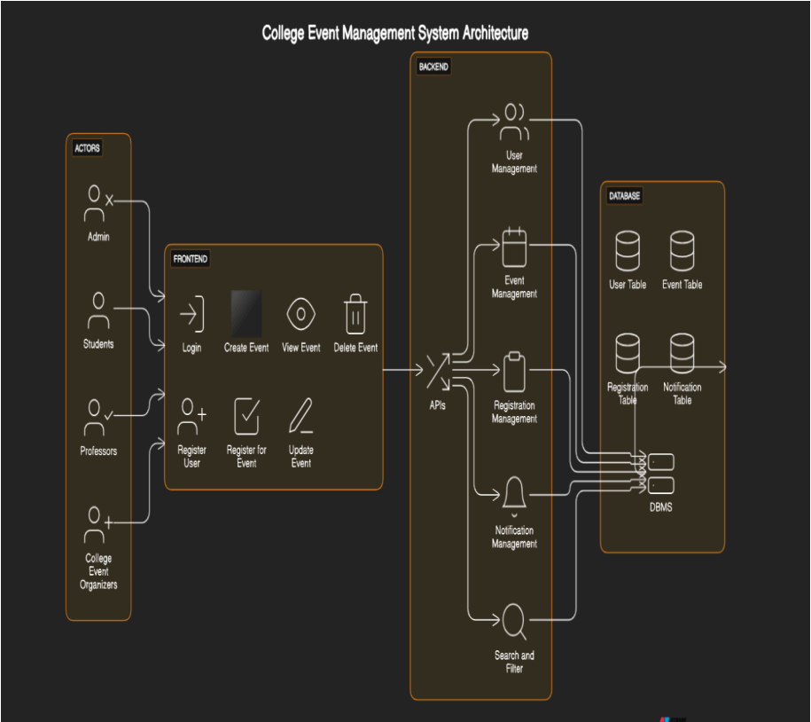
System Architecture

Slide 20
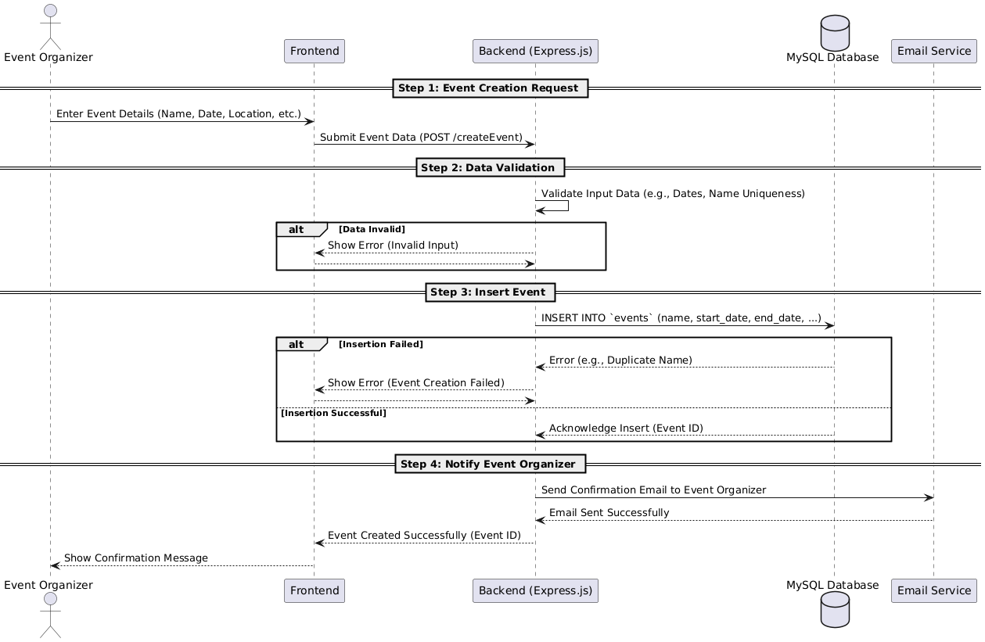
Sequence Diagram

Slide 21
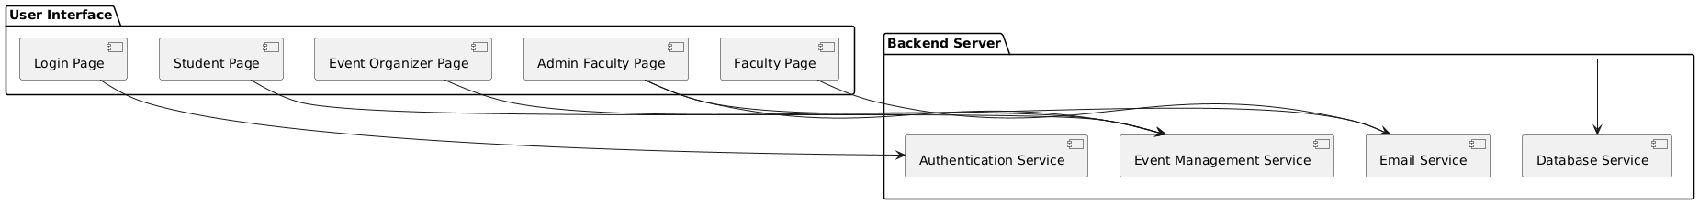
Component Diagram
The Component Diagram illustrates how the major components of the Event Management System interact:
User Interface (UI): The front-end where users (students, faculty, event organizers, admin faculty) interact with the system, built using HTML, CSS, and JavaScript.
Backend Server: Handles requests from the UI, processes data, and communicates with the database, built using Express.js and Node.js.
Database: Stores all data (user details, event info, registrations) in MySQL, ensuring data persistence and accessibility.

Slide 22
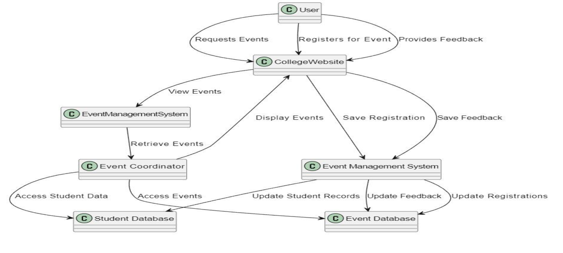
DFDs

Slide 23
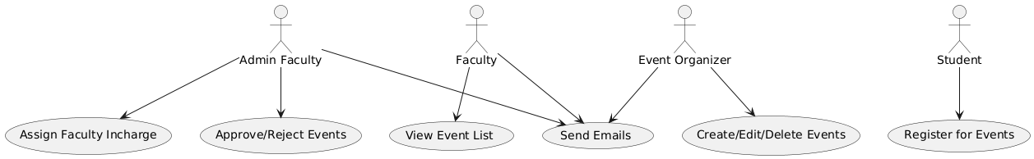
Use Case Diagram
Key Actors and Their Roles
Admin Faculty: Manage event approvals, assign faculty, edit, and delete events.
Faculty: Notify students, register for events, and view event details.
Event Organizers: Create, edit, delete events, and access participant data.
Students: Register for events, view details, and receive notifications.

Slide 24
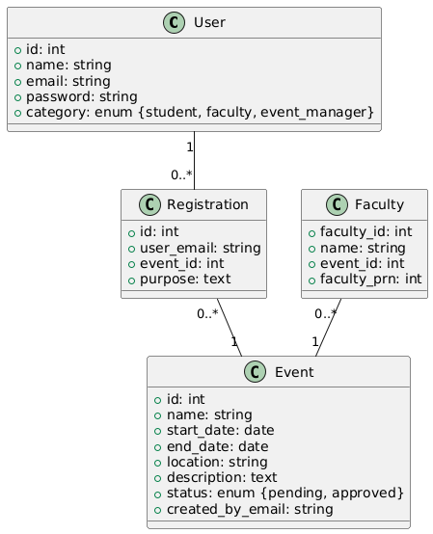
Class Diagram
User: Attributes include name, email, password, and category. Methods: login(), register(), sendEmail().
Event: Attributes include name, dates, location, and status. Methods: createEvent(), updateEvent(), cancelEvent().
Registration: Attributes include registration date, student name, email, event ID, and event name. Methods: registerUser(), sendConfirmation().
Relationships:
A User can have multiple Registrations.
An Event can have multiple Registrations.

Slide 25
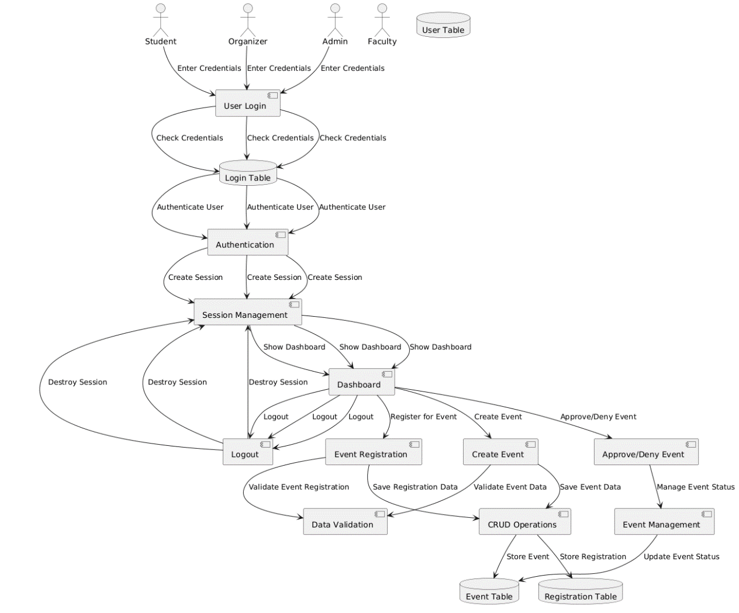
Workflow Diagram

Slide 26
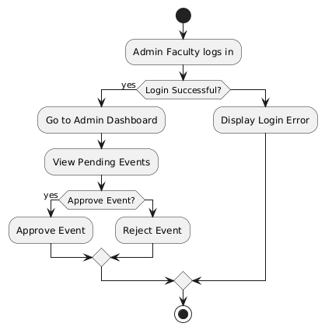
Activity Diagram(Event Approval Process)
Purpose Illustrates the steps and decisions involved in the admin faculty's event approval process.
Key Steps
Admin logs into the system and navigates to the event approval page.
Reviews event details like dates, location, and description.
Decision Point:
If correct: Approves the event, updating the status to "approved" in the database.
If incorrect: Rejects the event, marking it as "denied" or deleting it.
Flow Highlights decision points and actions, ensuring clarity in the approval process.

Slide 27
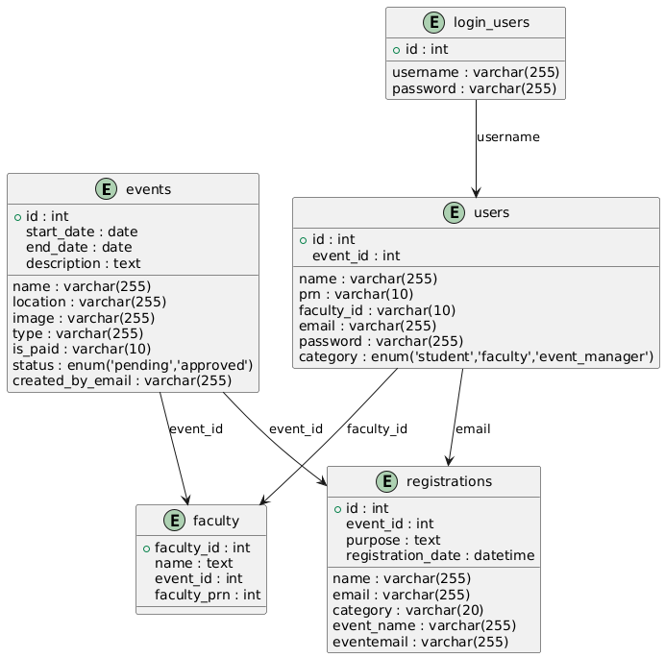
ERD (Entity-Relationship Diagram)
The ERD below illustrates the relationships between different entities within the EMS database, showing how the users, events, and registrations are connected.
Entities:
Events: Stores event details such as name, date, location, and status.
Users: Captures information about students, faculty, and organizers, including their roles and credentials.
Registrations: Tracks event participation, including registration dates, purpose,image, and linked user information.
Faculty: Manages faculty assignments for events.
Login Users: Ensures secure authentication for system users.
Relationships:
Login Users → Users: A one-to-one relationship exists between login_users and users, as each user must have one unique login credential.
Users → Registrations: A one-to-many relationship exists, where each user can register for multiple events
Events → Registrations: A one-to-many relationship exists, where each event can have multiple registrants.
Events → Faculty: A many-to-one relationship exists, where multiple faculty members can be associated with a single event.

Slide 28
Database Design
Users Table
Stores user details, including roles (student, faculty, event manager
Attributes: id, name, prn, email, password, category.
2. Events Table
Maintains event details like name, date, location, and status.
Attributes: id, name, start_date, end_date, location, status, created_by_email.
3. Faculty Table
Tracks faculty assignments for specific events.
Attributes: faculty_id, name, event_id, faculty_prn.

Slide 29
Database Design
4. Registrations Table
Records participant registrations for events.
Attributes: id, name, email, event_id, event_name, purpose, registration_date.
5. Login Table
Stores admin login credentials securely.
Attributes: id, username, password.
6. Relationships Between Tables
Login Users → Users: A one-to-one relationship exists between login_users and users, as each user must have one unique login credential.
Users → Registrations: A one-to-many relationship exists, where each user can register for multiple events
Events → Registrations: A one-to-many relationship exists, where each event can have multiple registrants.
Events → Faculty: A many-to-one relationship exists, where multiple faculty members can be associated with a single event.

Slide 30
Implementation
The EMS will be developed in an agile manner, with iterative sprints to ensure regular testing and updates:
Backend:
Node.js REST APIs for CRUD operations.
Express.js for routing.
Frontend:
Dynamic EJS templates for responsive UI.
Database:
MySQL for storing users, events, and registrations.

Slide 31
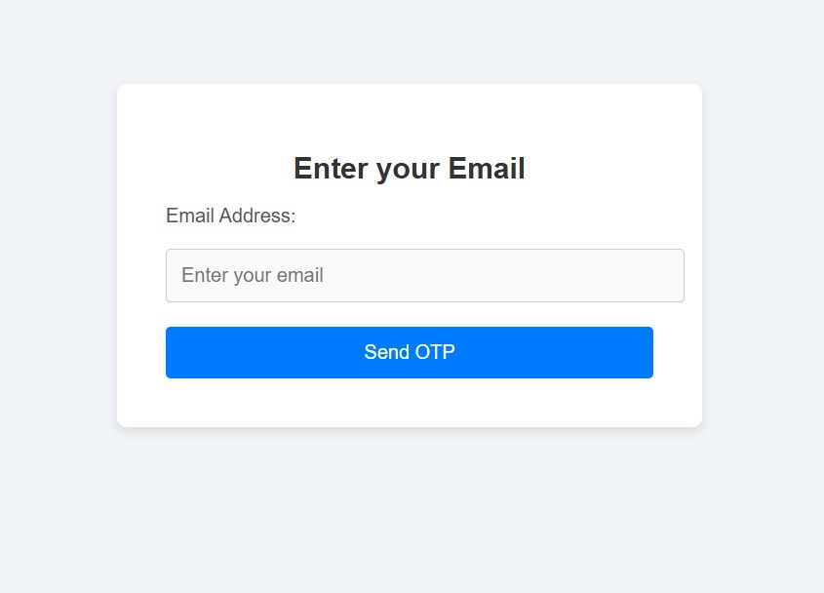
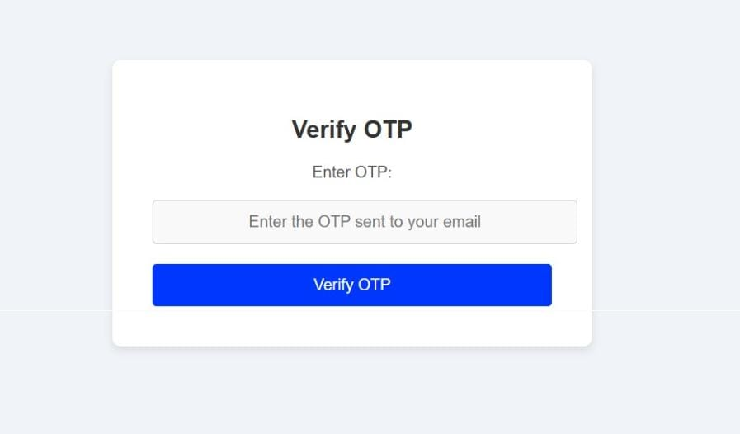
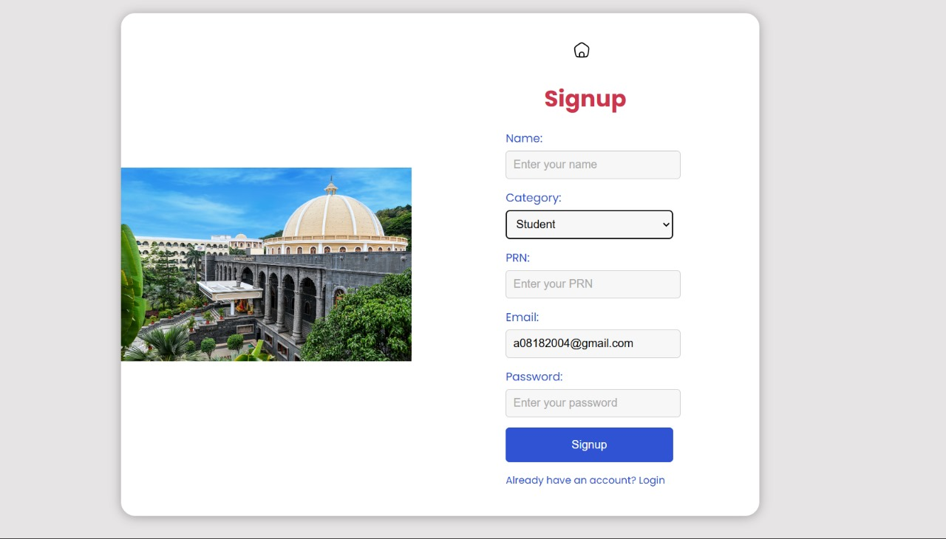
Implementation

Slide 32
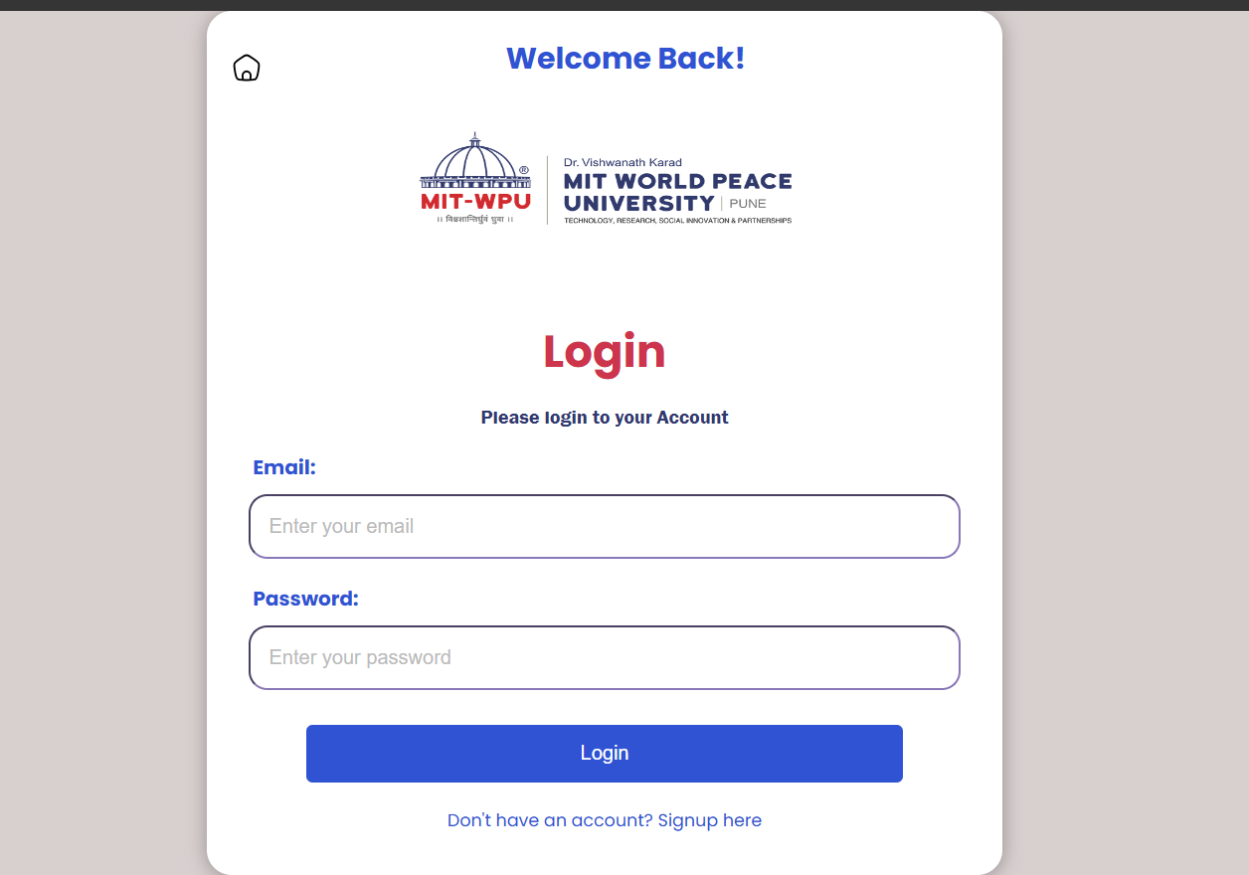
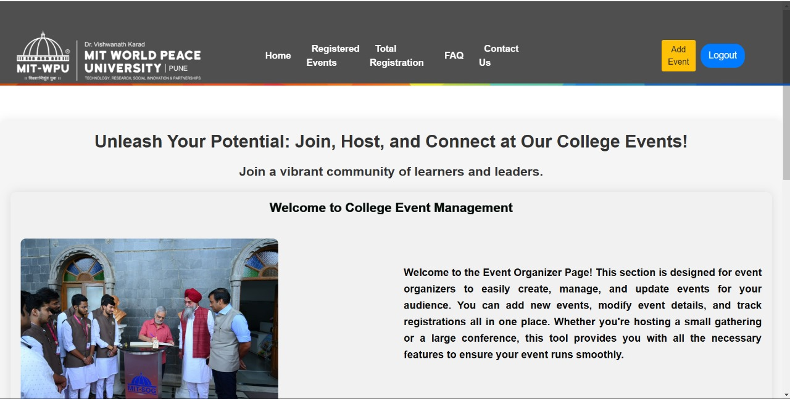
Implementation

Slide 33
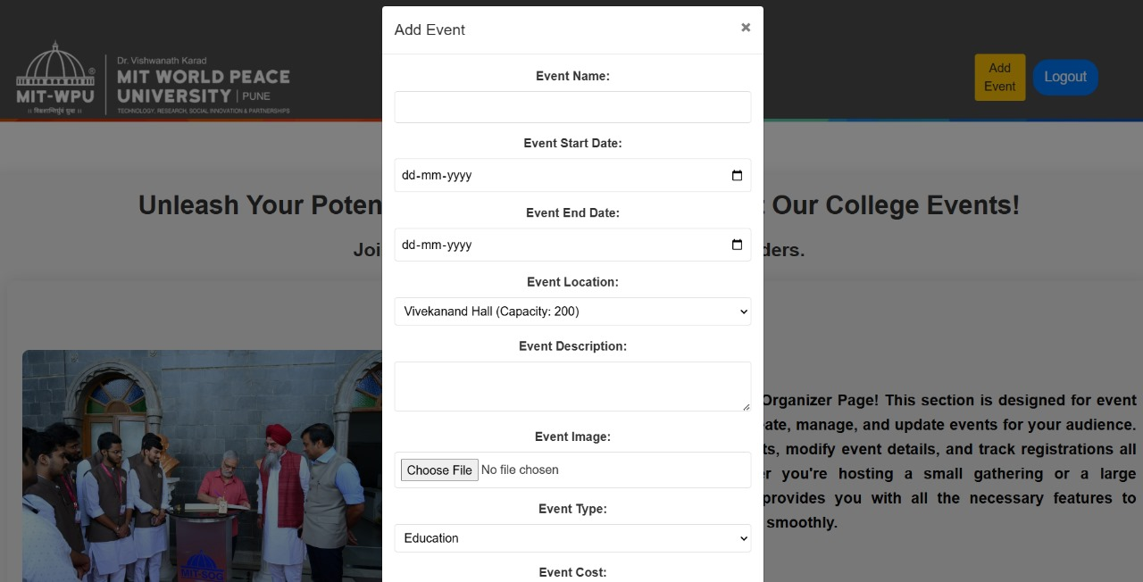
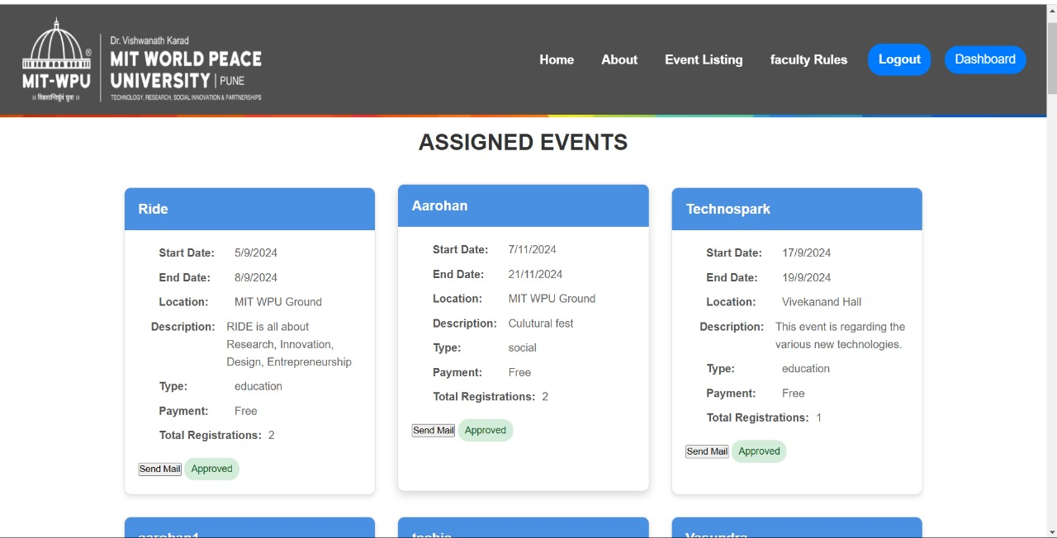
Implementation

Slide 34
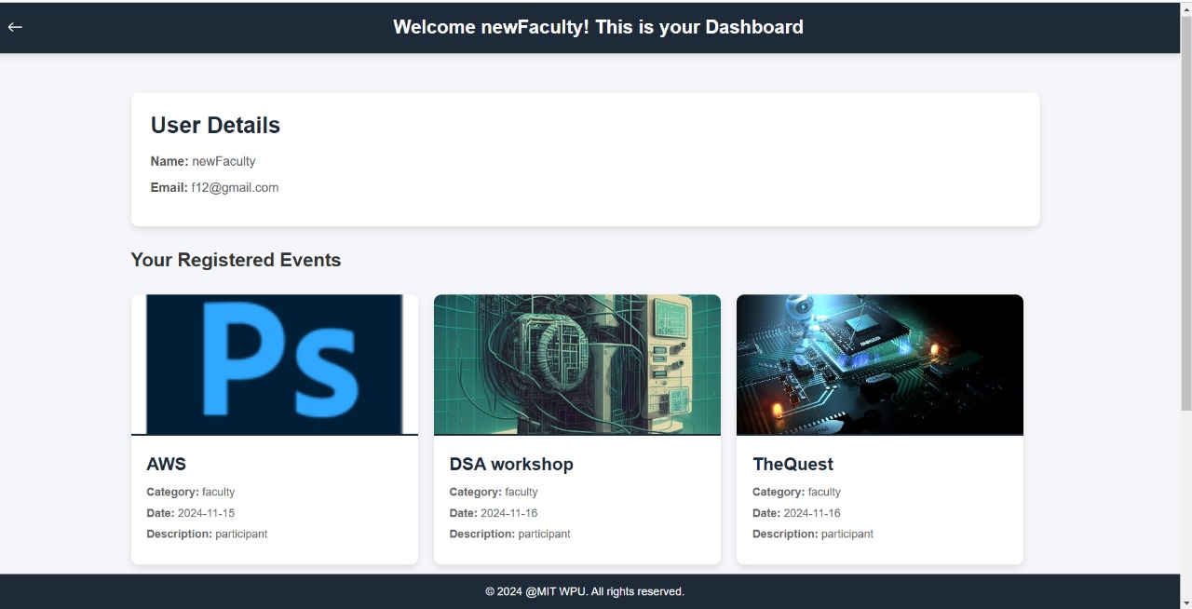
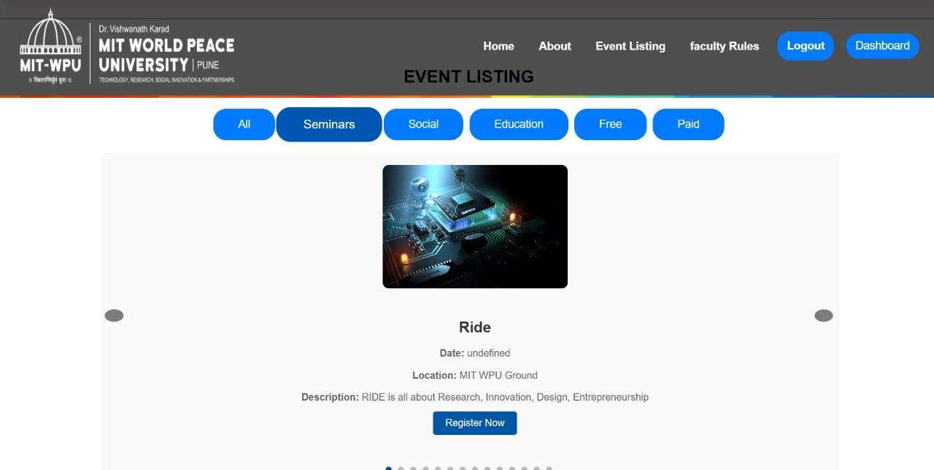
Implementation

Slide 35
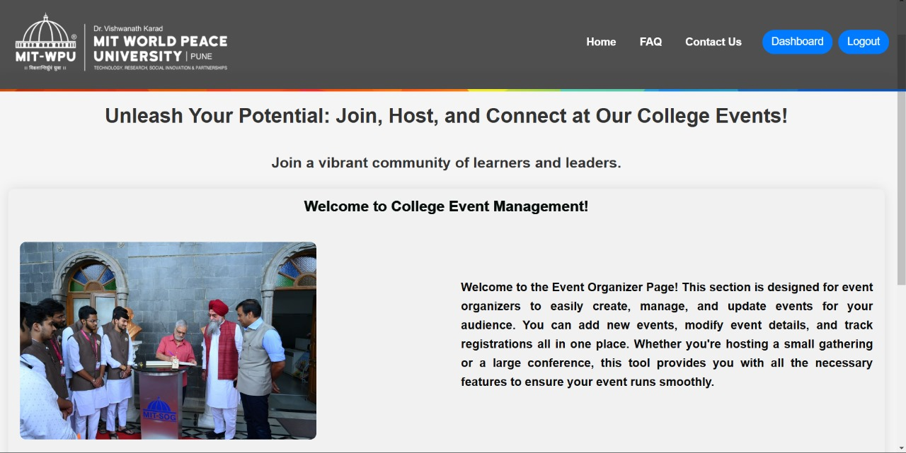
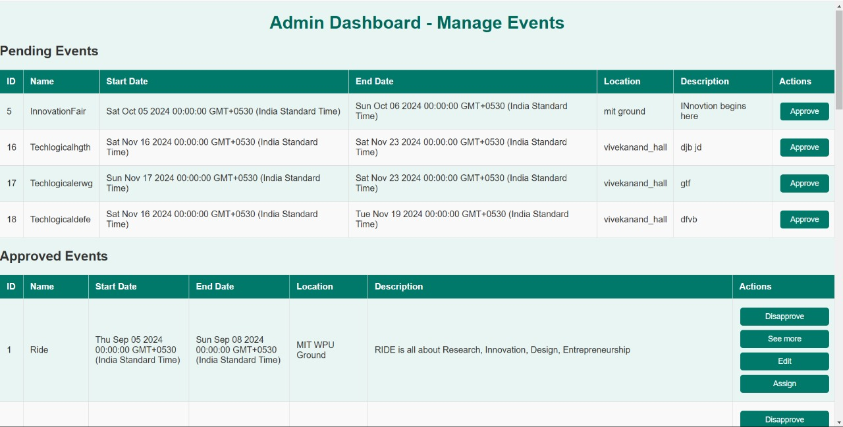
Implementation

Slide 36
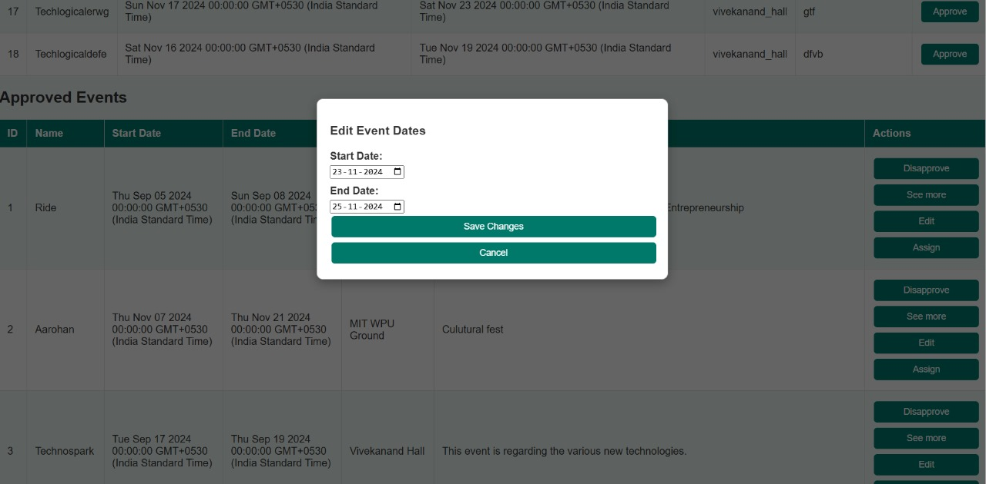
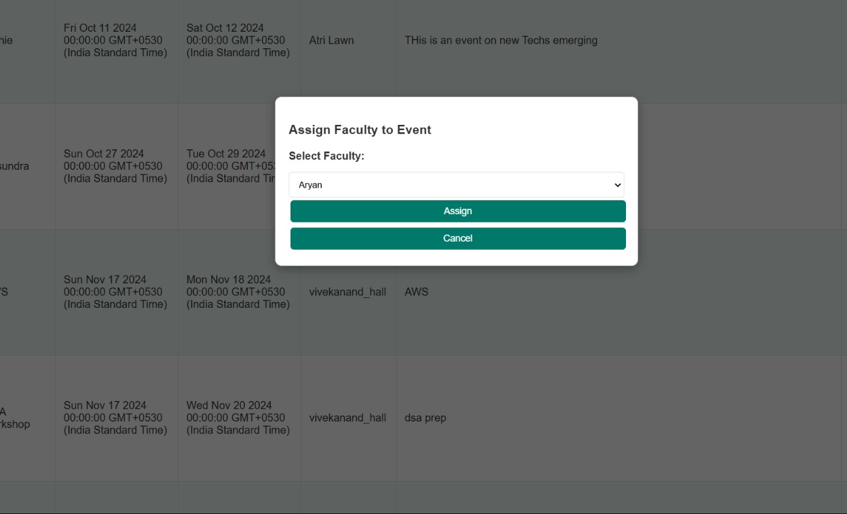
Implementation

Slide 37
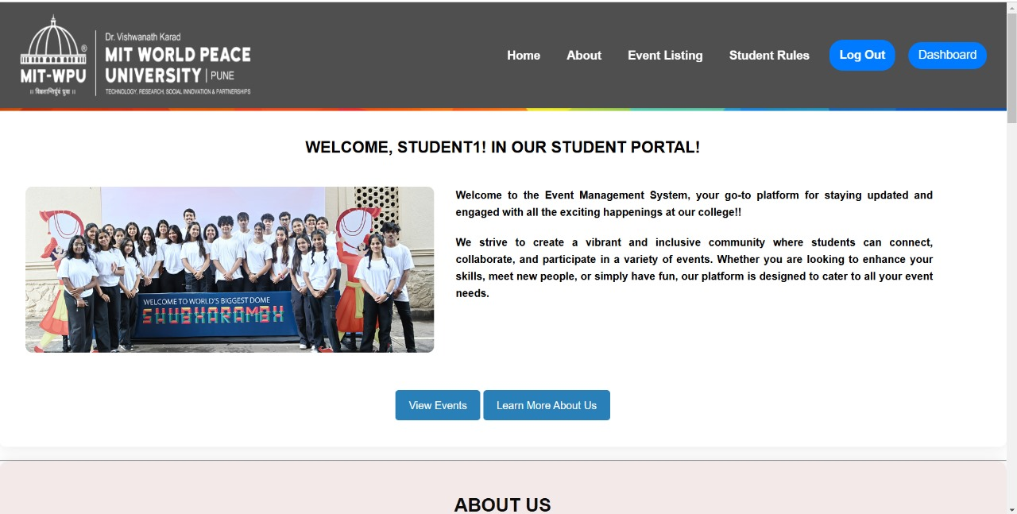
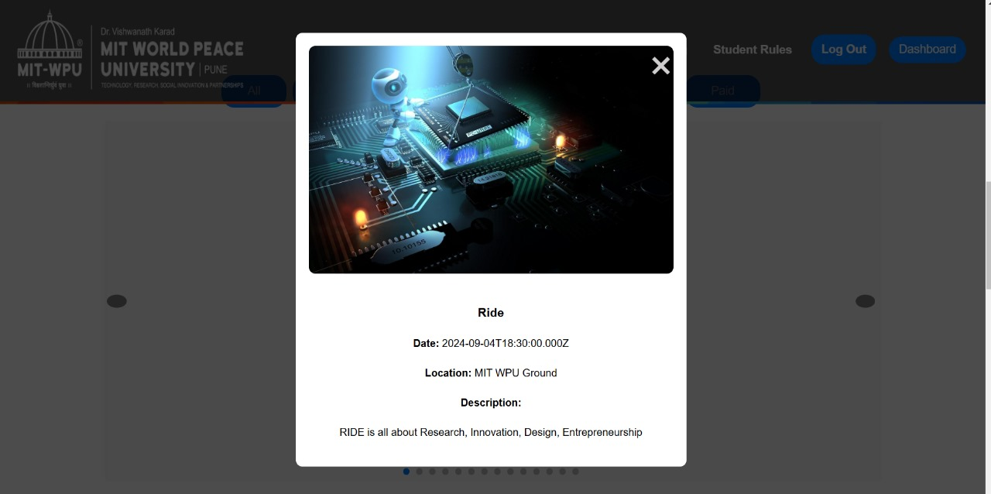
Implementation

Slide 38
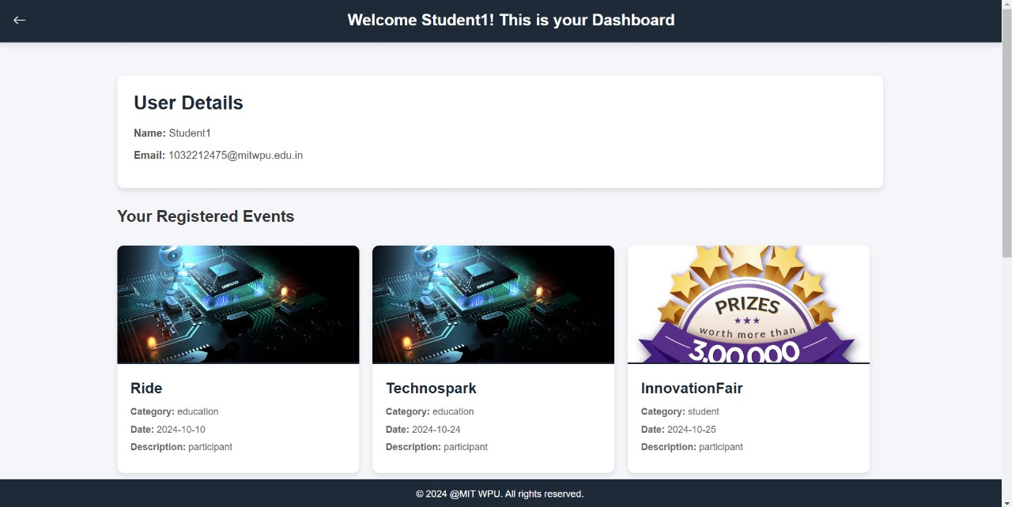
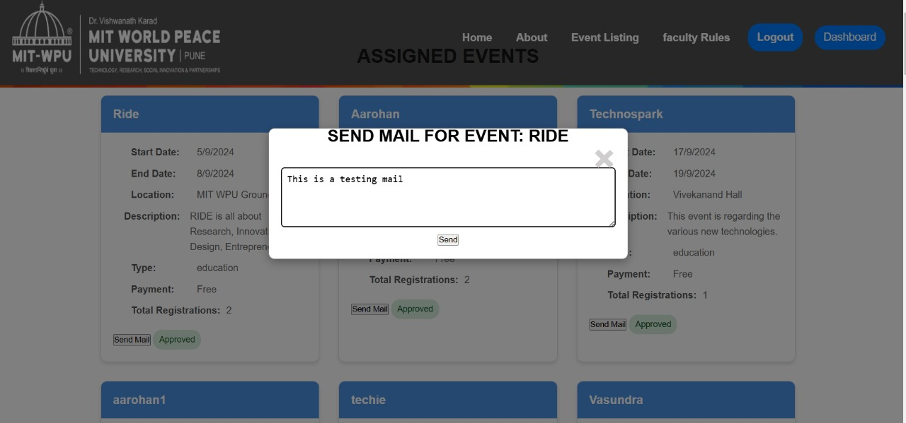
Implementation

Slide 39
Security Measures
Password hashing using bcrypt.
Email OTP verification during signup.
Sessions and cookies for validation.
Restricted access based on user roles.

Slide 40
Testing
Unit Testing:
Validated individual components like login, signup, and email functionality.
Ensured proper error handling and OTP delivery.
2. Integration Testing:
Verified seamless interaction between modules (e.g., event creation, email notifications, and faculty assignments).
3. User Testing:
Conducted with sample users to evaluate system usability.
Collected feedback and resolved issues to improve user experience.

Slide 41
Individual Contributions (Member 1)
Login Page:
Designed an intuitive login interface that supports role-based authentication for students, faculty, event organizers, and admin faculty.
Implemented error handling to block unauthorized access and display clear error messages for invalid credentials.
Signup Page:
Developed a secure registration system using email OTP verification to validate user identities.
Used bcrypt for password hashing to enhance database security, ensuring sensitive user information is protected.

Slide 42
Individual Contributions (Member 2)
Faculty Page:
Designed an intuitive login interface that supports role-based authentication for students, faculty, event organizers, and admin faculty.
Implemented error handling to block unauthorized access and display clear error messages for invalid credentials.
Student Page:
Designed a user-friendly interface for students to browse available events and register seamlessly.
Incorporated real-time updates to display the status of event registrations and notifications.

Slide 43
Individual Contributions (Member 3)
Event Organizer Page
Event Creation and Management:
Designed and developed a page where event organizers can create, edit, or delete events.
Integrated validation checks to prevent duplicate entries and ensure accurate event details are saved.
Participant Data and Notifications:
Provided event organizers with tools to view total number of participant.
User-Friendly Design:
Focused on creating an intuitive interface that simplifies event management tasks for organizers.

Slide 44
Individual Contributions (Member 4)
Admin Page
Event Approval and Management:
Developed a page where admin faculty can approve or deny event requests submitted by event organizers.
Implemented functionality to assign a faculty member as an in-charge for specific events.
Automated Notifications:
Automated the process of notifying registered students via email when event dates are changed or canceled.
Integrated backend triggers to ensure real-time updates and seamless notification delivery.
Role-Based Security:
Implemented robust role-based access controls to ensure admin-specific operations remain secure.

Slide 45
Future Aspects
Mobile Optimization:
Improve mobile responsiveness for on-the-go event management with a seamless user experience.
Real-Time Chat:
Enable quick query resolution through a live chat feature for participants and organizers.
Advanced Analytics:
Track participation trends and provide actionable insights for better event planning.
Diverse Event Support:
Extend features to handle various events like conferences, festivals, and tournaments, ensuring scalability.

Slide 46
Conclusion
The creation of our College Event Management System represents a pivotal advancement in reshaping how we manage and coordinate college events.
CEMS embodies our dedication to efficiency and user-centric design, providing a seamless platform for event planning, registration, and engagement.
Its intuitive interface has earned accolades for its simplicity and effectiveness, underscoring our commitment to user satisfaction.
Looking ahead, we envision CEMS evolving to meet the ever-changing needs of our college community, ensuring its continued relevance and effectiveness in facilitating memorable and successful events.

Slide 47
References
[1] M. Smith, "Event Management Systems: A Survey of Current Practices," Journal of Information Technology, vol. 33, no. 4, pp. 240-251, Dec. 2019. doi: 10.1016/j.jit.2019.09.004.
[2] A. Kumar and S. Verma, "Designing a Robust Event Management System: Key Principles and Best Practices," International Journal of Computer Applications, vol. 49, no. 7, pp. 11-16, Oct. 2020. doi: 10.5120/ijca202012181234.
[3] P. Brown and L. Jackson, "A Study on Event Registration Systems," IEEE Access, vol. 7, pp. 151233-151245, Dec. 2020. doi: 10.1109/ACCESS.2020.3028234.
[4] J. S. Lee, "Web Development for Event Management: Challenges and Solutions," Proceedings of the International Conference on Web Technologies, Barcelona, Spain, 2018, pp. 120-125. doi: 10.1109/WebTech.2018.00020.
[5] S. R. Sharma, "Optimizing Database Performance for Event Management Systems," Journal of Database Management, vol. 30, no. 2, pp. 75-85, Apr. 2021. doi: 10.1016/j.jdbm.2021.03.005.
[6] H. T. Nguyen, "Event Management Systems: A Web-based Approach for Universities," International Journal of Computer Science and Technology, vol. 10, no. 3, pp. 112-119, Jun. 2019. doi: 10.1109/ICST.2019.0912.
[7] D. A. Johnson and M. K. Smith, "Database-Driven Event Management: A Case Study," Journal of Computer Science & Engineering, vol. 45, no. 4, pp. 221-233, Sept. 2020. doi: 10.1109/JCE.2020.00564.
[8] B. J. Davis and K. R. Tan, "User Interface Design for Event Management Systems," Proceedings of the 2021 IEEE International Conference on Human-Computer Interaction, Washington, DC, 2021, pp. 332-337. doi: 10.1109/HCI.2021.00054.

Slide 48
References
[9] J. M. Gupta and R. N. Yadav, "Event Management System Architecture for Educational Institutions," International Journal of Information Systems, vol. 9, no. 5, pp. 122-130, May 2020. doi: 10.5121/ijis.2020.9507.
[10] S. L. Thompson and P. J. Clark, "Role-based Access Control for Event Management Systems," IEEE Transactions on Software Engineering, vol. 42, no. 3, pp. 299-309, Mar. 2021. doi: 10.1109/TSE.2021.009423.
[11] M. A. Jenkins, "Event Management: A Comparative Study of Different Platforms," Journal of Cloud Computing, vol. 17, no. 4, pp. 132-141, Oct. 2021. doi: 10.1109/JCC.2021.00592.
[12] R. G. Patel and A. C. Verma, "Event Management System Using Web Technologies and Databases," Journal of Computer Science and Applications, vol. 25, no. 2, pp. 143-150, Jul. 2020. doi: 10.1109/JCSA.2020.00045.
[13] D. T. Rivera and M. P. Davis, "Effective Event Registration Through Relational Databases," International Journal of Data Science and Analysis, vol. 13, no. 3, pp. 211-218, May 2020. doi: 10.1109/IJDSA.2020.011234.
[14] L. W. Collins and J. R. Wright, "Scalable Solutions for Event Management in Large Institutions," Proceedings of the IEEE Global Conference on Web Development, Dublin, Ireland, 2020, pp. 72-77. doi: 10.1109/GWDC.2020.00467.
[15] P. J. Ray and S. D. Adams, "Security and Data Integrity in Event Management Systems," IEEE Transactions on Information Security, vol. 13, no. 2, pp. 192-202, Feb. 2021. doi: 10.1109/TIS.2021.00034.

